Slide 1

END-TO-END HEAT TRANSFER SOLUTIONS
Engineering | Fabrication | Repair

Slide 2
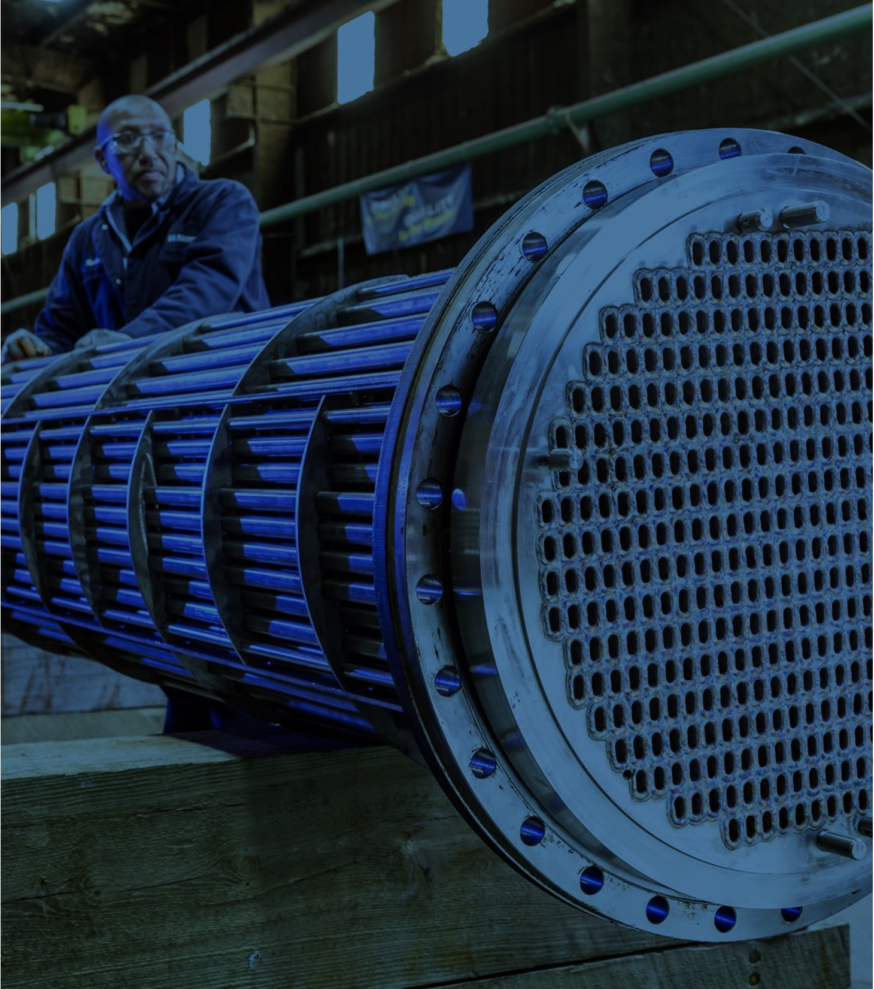
Who we are
Metalforms is driven by a clear vision: to be the preferred heat transfer partner. We aim to be the team called when operational changes create strain on existing systems and complex challenges demand proven expertise.
By combining decades of engineering experience with advanced solutions such as custom shell and tube exchangers, BROWN FINTUBE® Hairpin Heat Exchangers, and TWISTED TUBE® Heat Exchanger Technology, we help customers solve critical performance issues, optimize efficiency, and strengthen long term reliability across their operations.
As part of the TransTech Group we deliver cutting-edge solutions that reduce emissions, improve efficiency, and increase profitability to help plant owners and operators achieve their energy management and sustainability goals with 24/7 support services for critical industries.

Slide 3
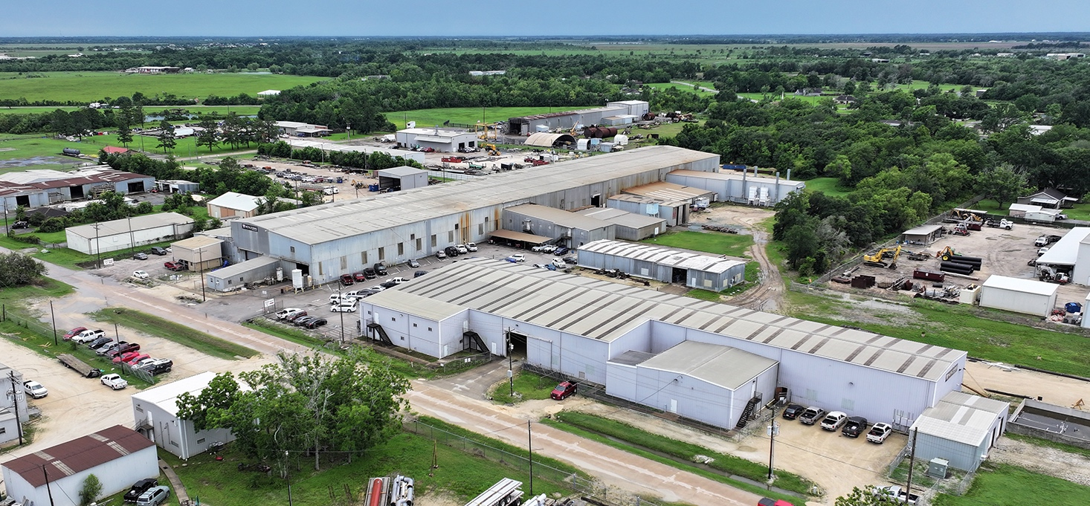
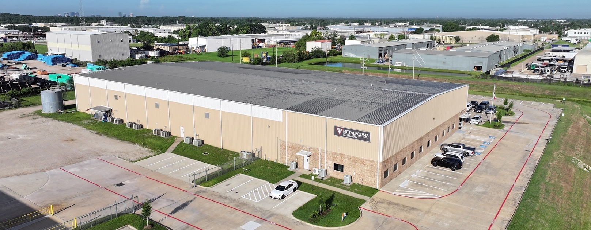
Metalforms history
1968
METALFORMS WAS FOUNDED
2022
BEGAN SUBCONTRACTING RELATIONSHIP WITH KHT, OPENED 2ND SHOP IN BEAUMONT
2023
ACQUIRED BY TRANSTECH GROUP
2024
2025
ACQUIRED KHT & FORMED METALFORMS HEAT TRANSFER DIVISION
ACQUIRED KHT ITALY & OPENED HOUSTON SHOP LOCATION
METALFORMS
170,000 SQ. FT.
BEAUMONT, TX
METALFORMS HEAT TRANSFER
55,000 SQ. FT.
HOUSTON, TX

Slide 4
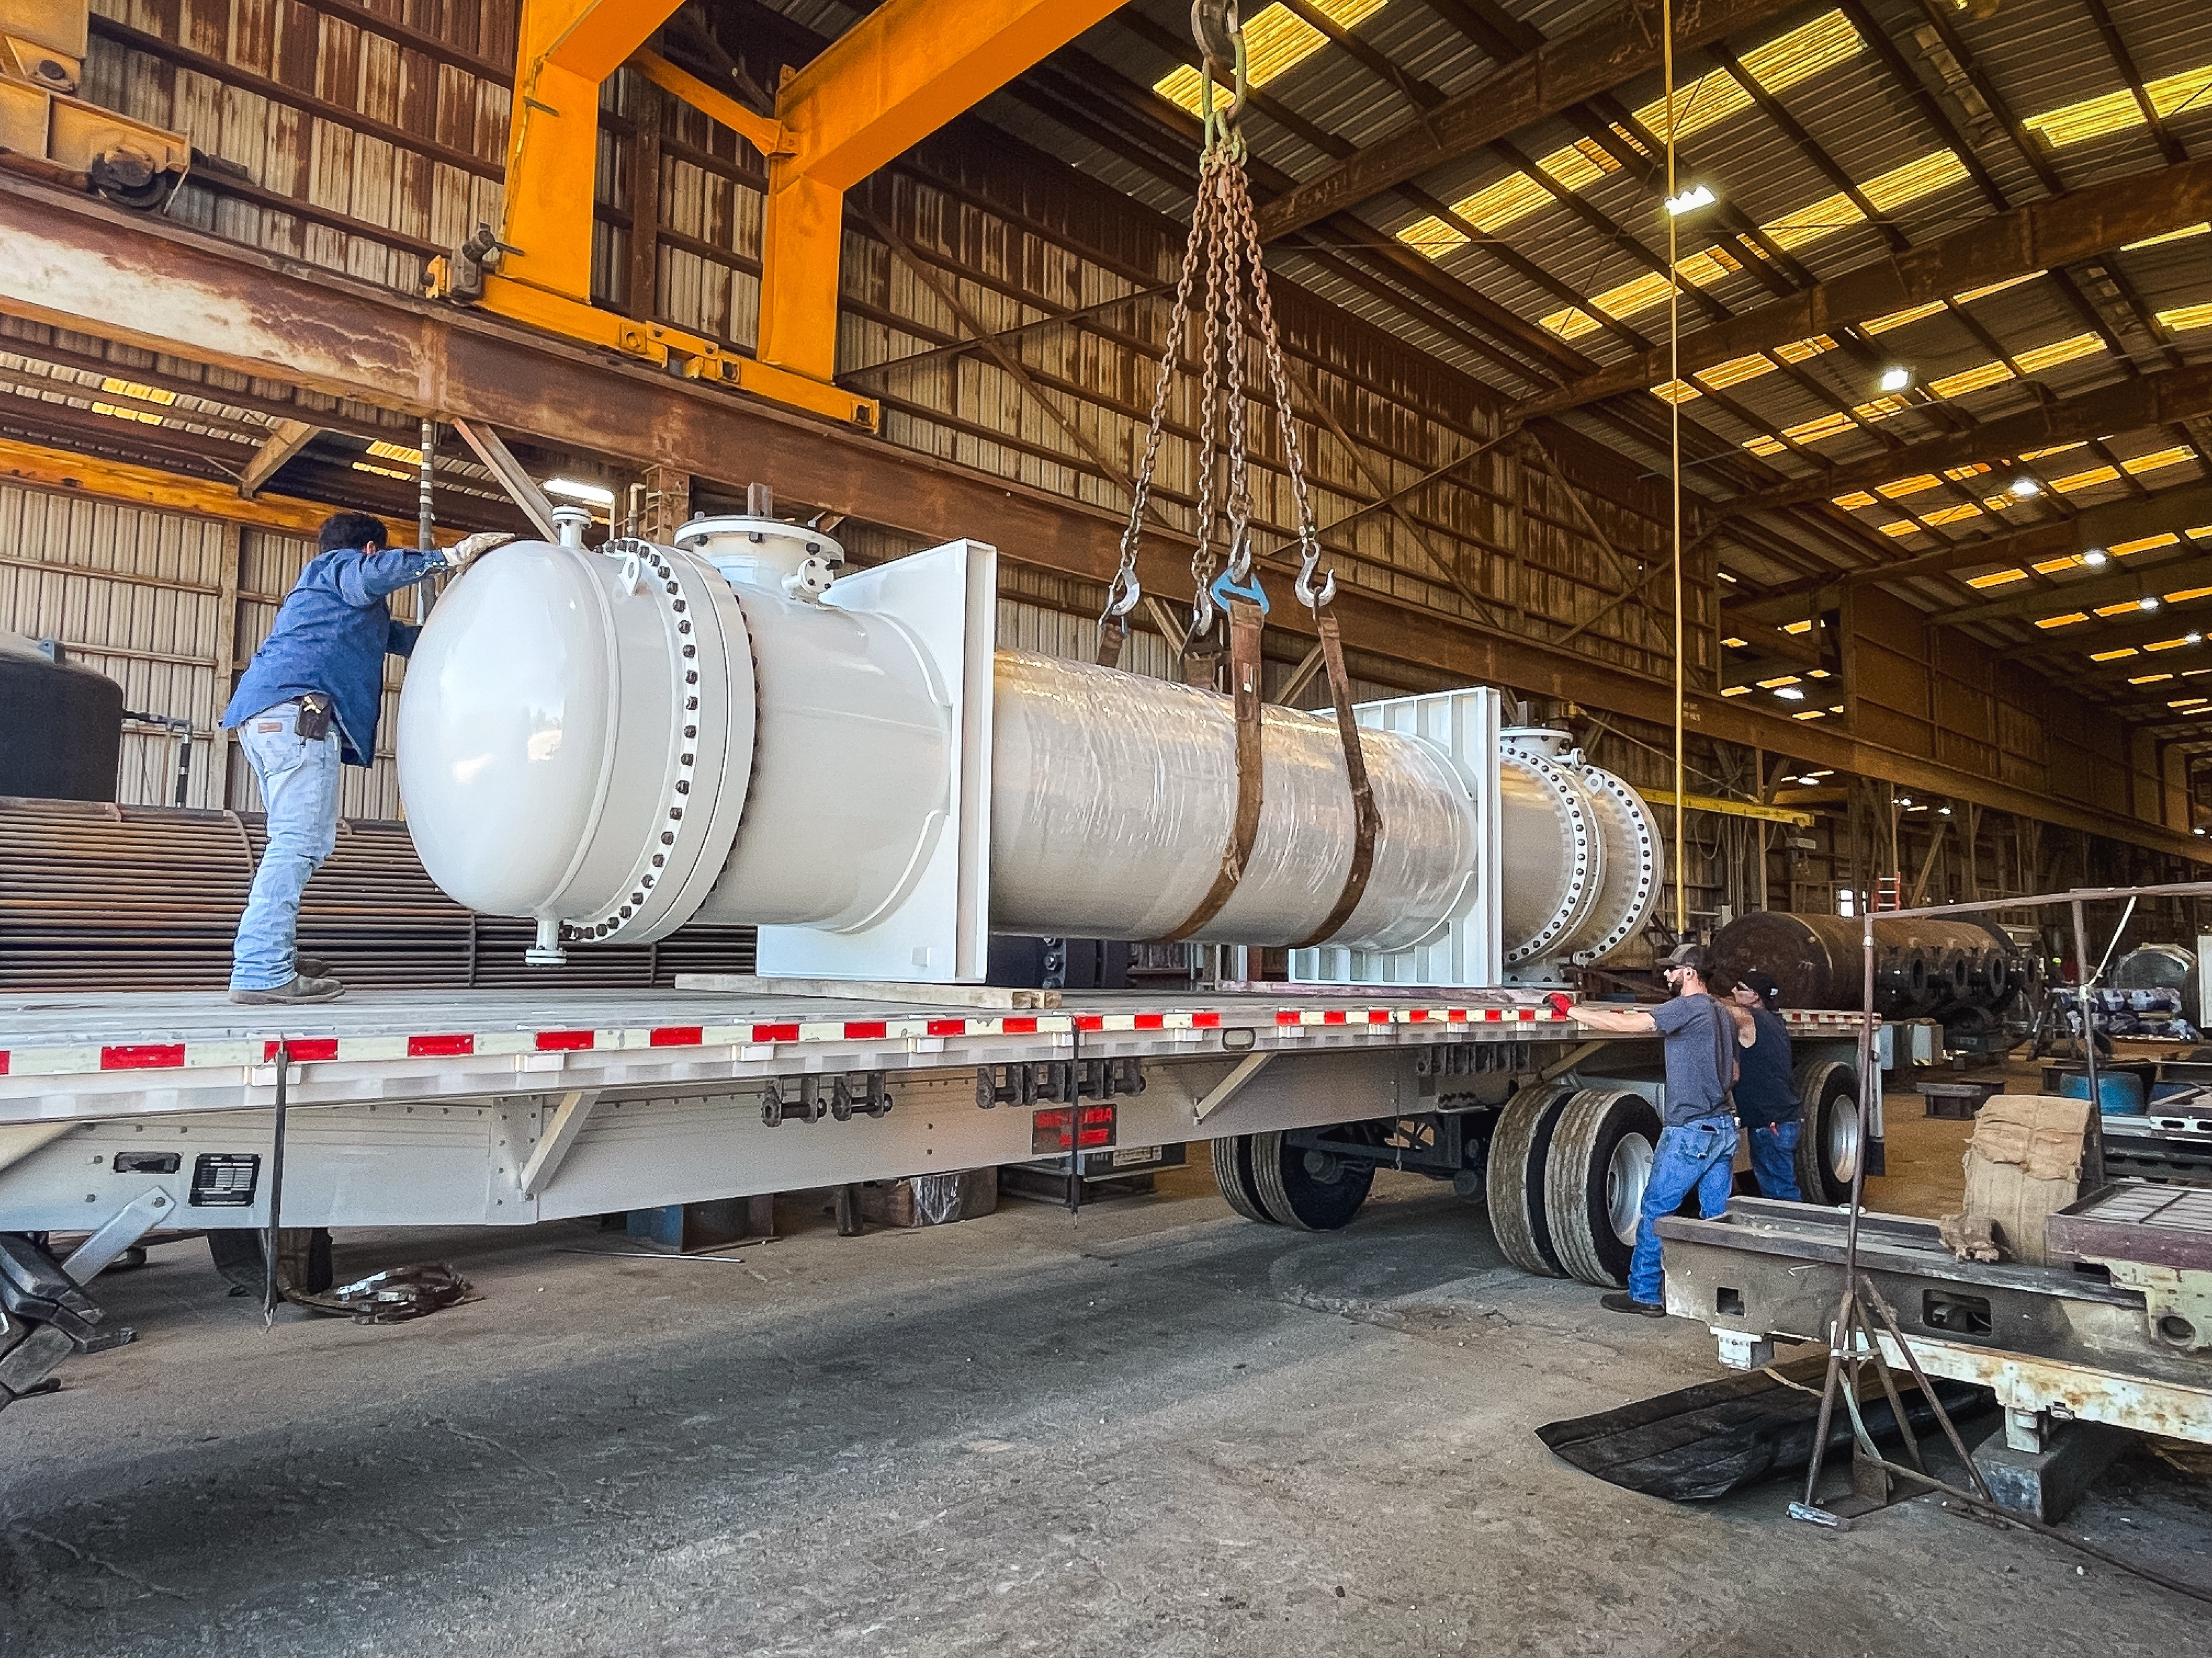
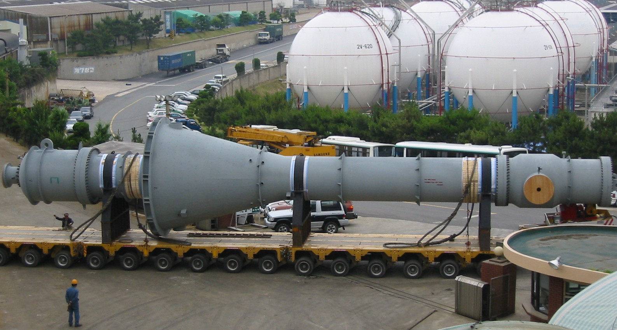
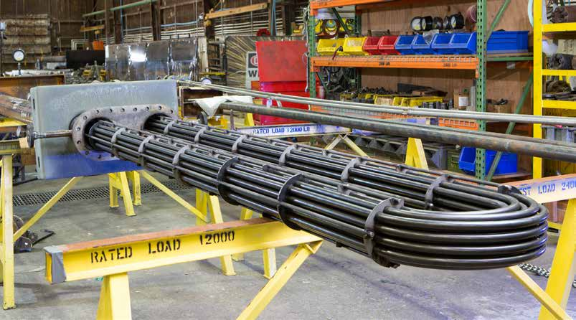
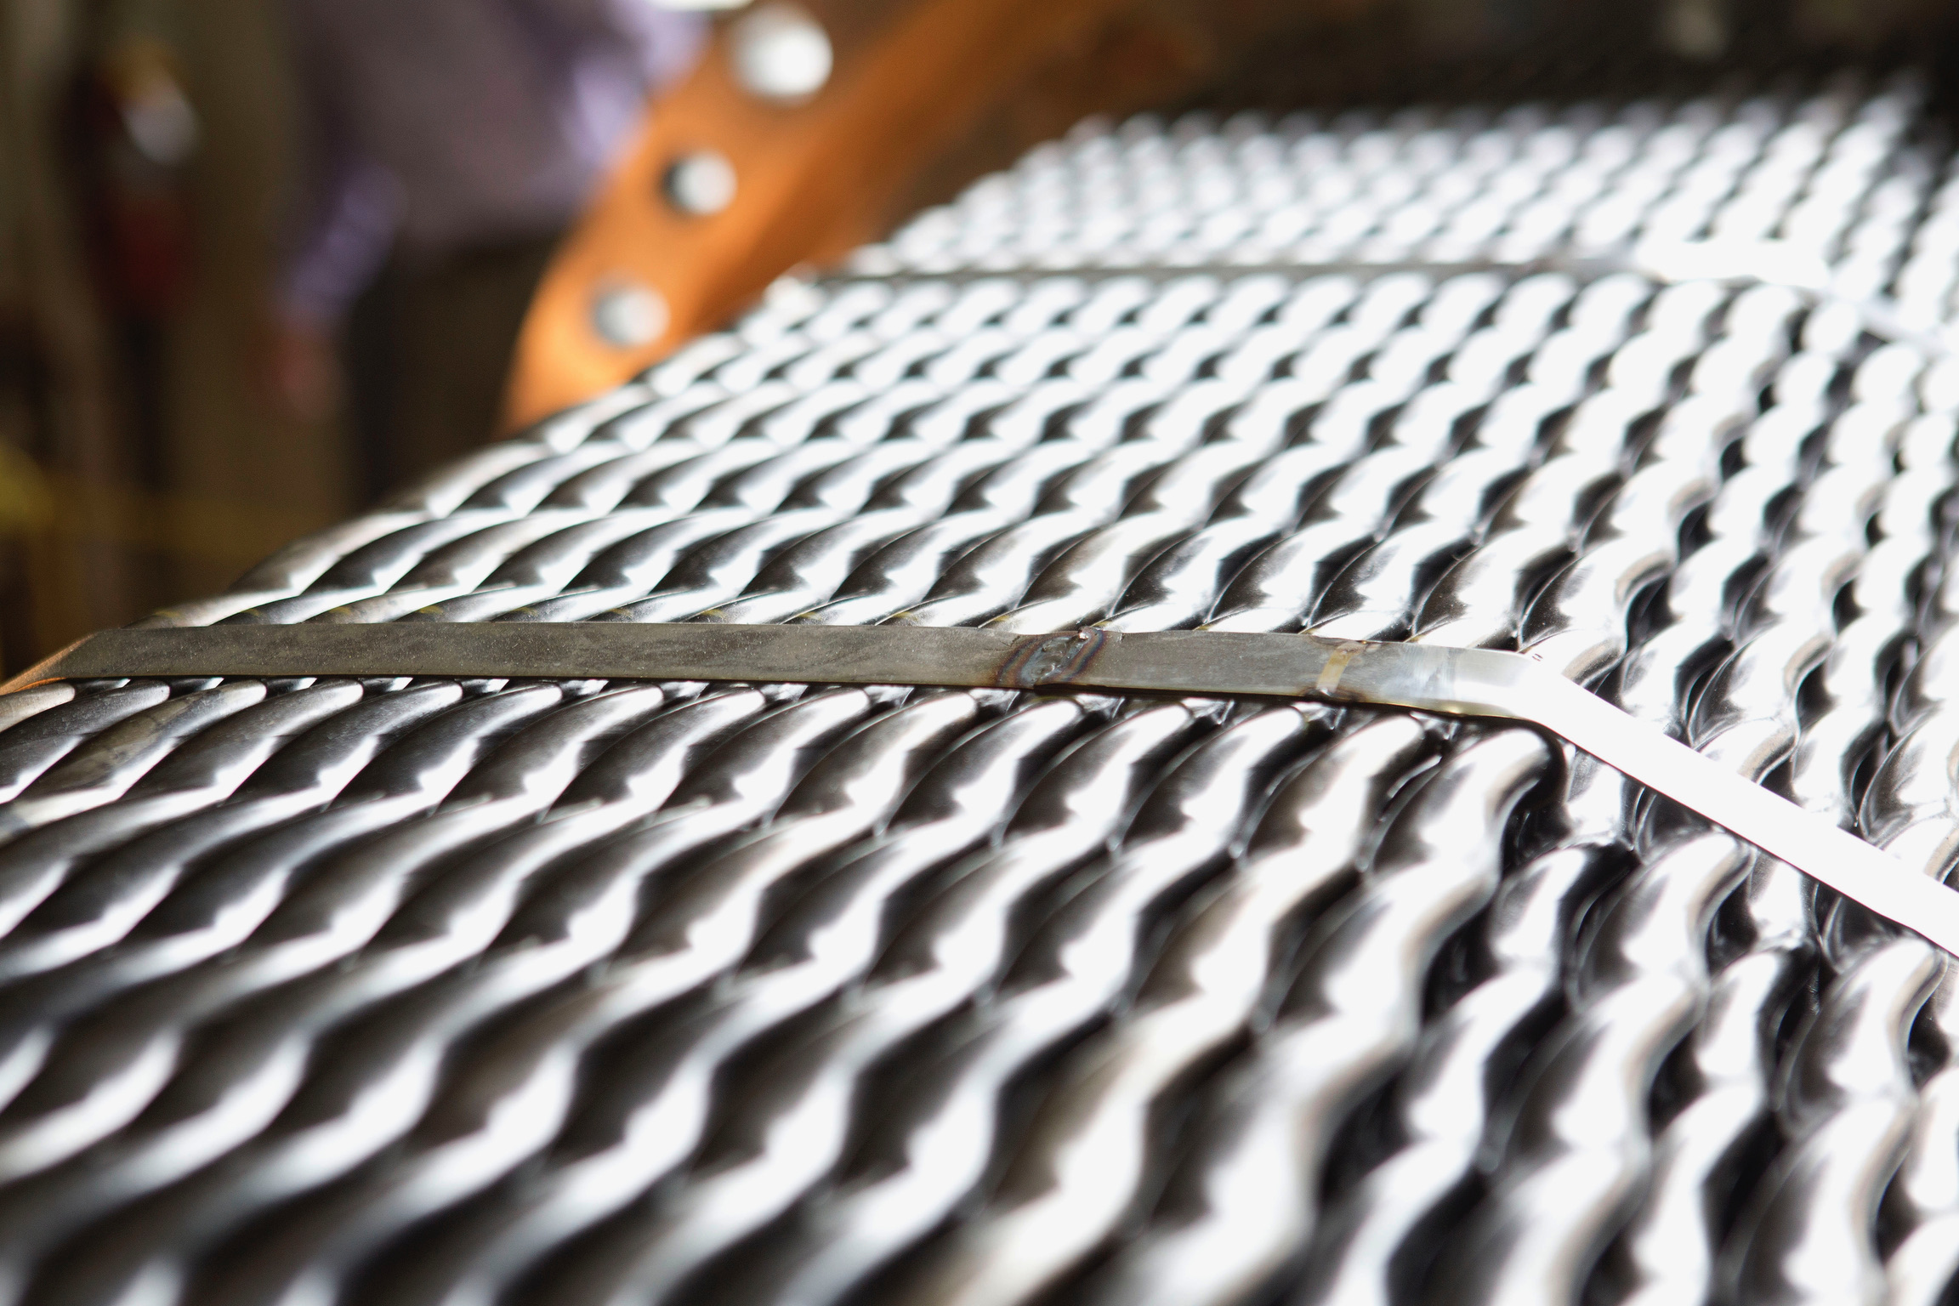
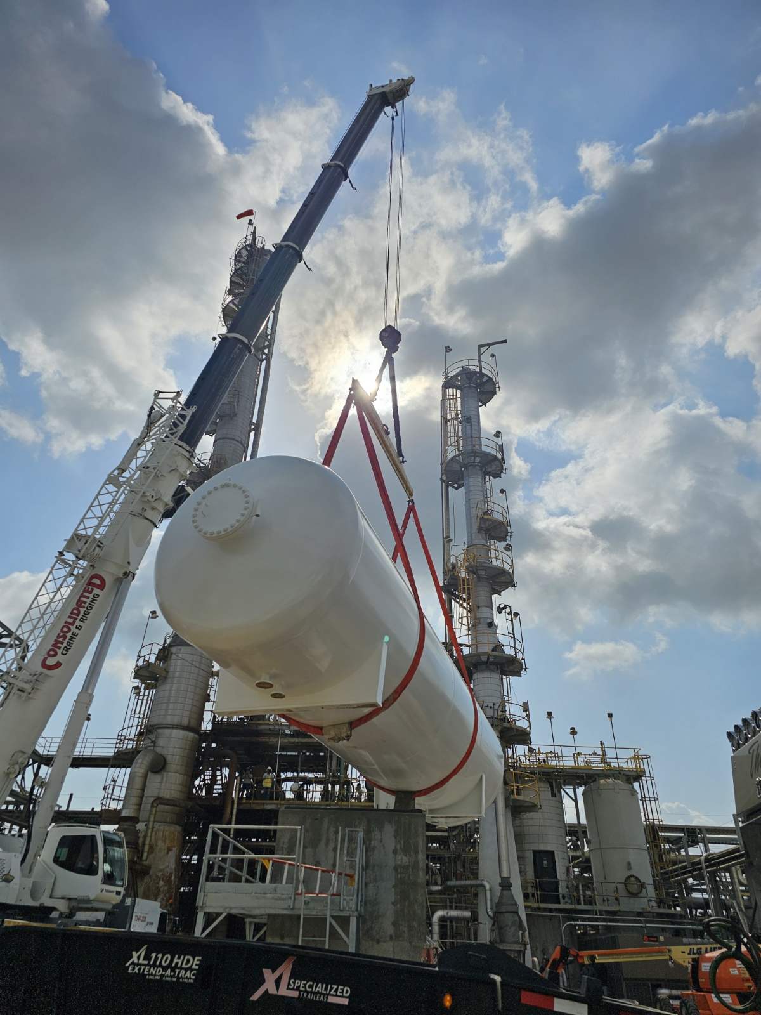
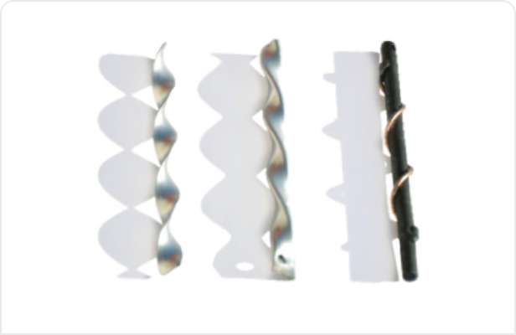
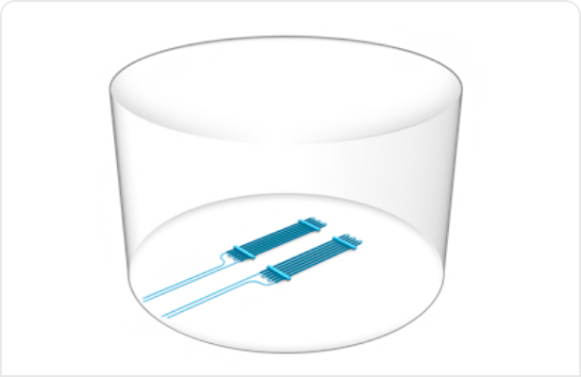
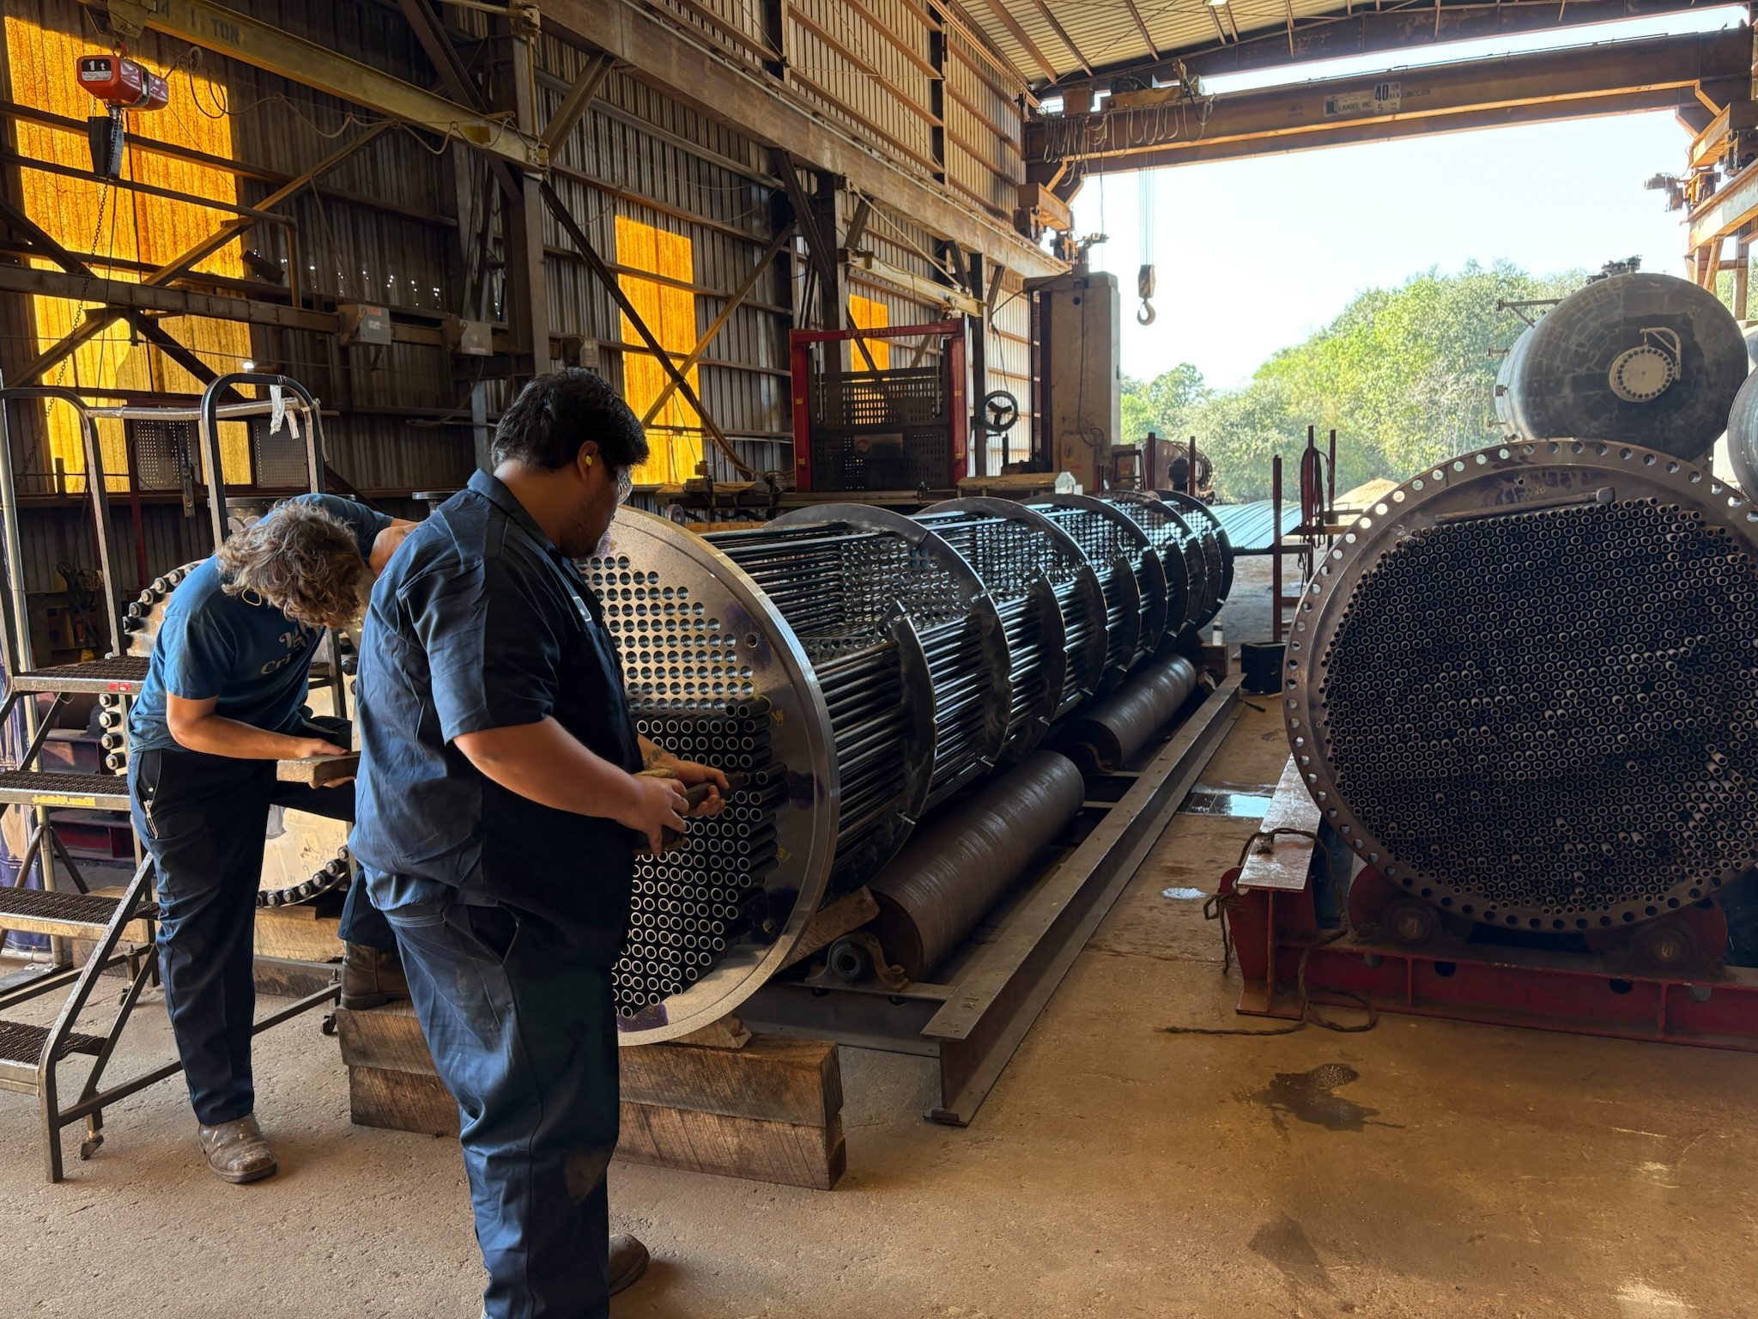
OUR offerings
TEMA type – Shell & Tube Heat Exchangers
Texas Towers
Hairpin Heat Exchangers
TWISTED TUBE® Heat Exchanger Technology
Pressure Vessels
Enhancement Devices
Tank Heating Products
Repairs

Slide 5
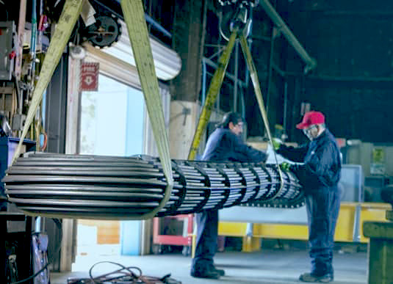
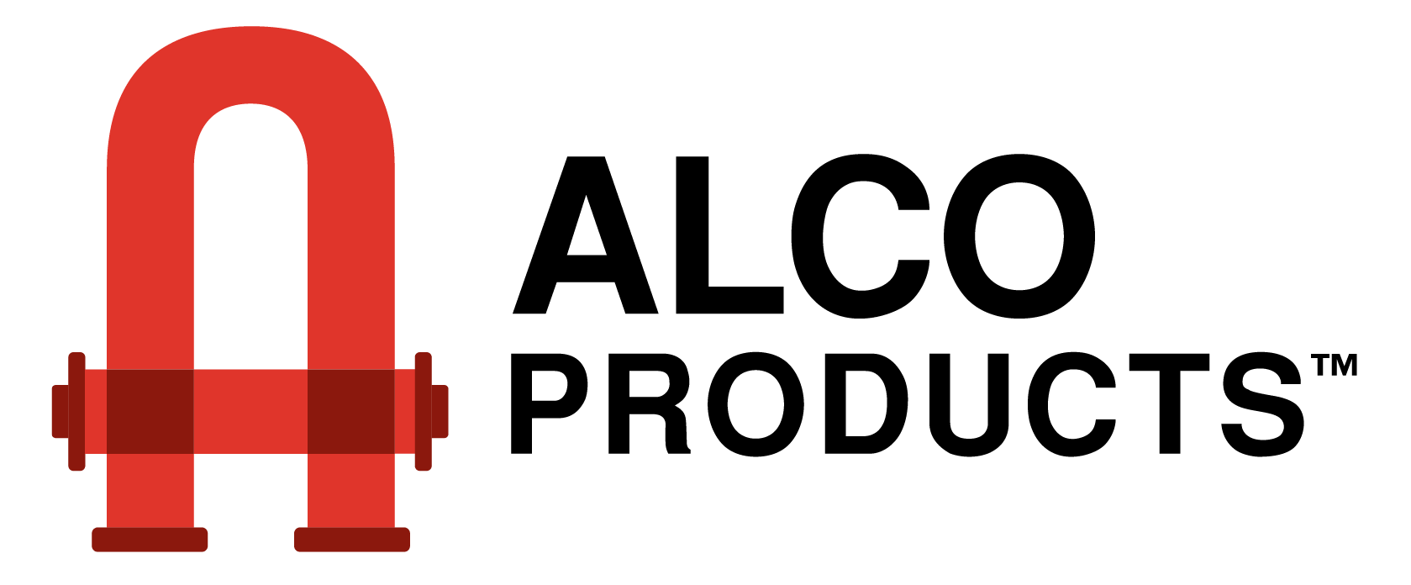
Legacy brands
BROWN FINTUBE® Products
TWISTED TUBE® Heat Exchanger Technology
ALCO® Hairpin
BOS-HATTEN® Heat Exchanger
Peerless Exchangers
ALCOTWIN™ Hairpin
BasTex Heat Exchangers
Nitram Energy Hairpin Heat Exchangers
Koch Engineering LP
Murihead Engineering Ltd.

Slide 6
Global Leadership in Thermal Solutions
Core Capabilities
Strategic Advantages
Metalforms operates as a global leader in heat transfer solutions, combining cutting-edge technology with deep engineering expertise.
World-class thermal engineering expertise
Gulf Coast regional presence for rapid response
Comprehensive end-to-end project capabilities
Based in Beaumont and Houston, Texas, our operations enable rapid project turnaround, emergency response capabilities, and seamless collaboration.
24/7 emergency repair and maintenance support
Geographic proximity + technical excellence = strategic advantage

Slide 7
Proprietary technology portfolio
Recent acquisition of Koch Heat Transfer's international operations has positioned Metalforms as the exclusive global source for industry-leading thermal technologies.
BROWN FINTUBE®
TWISTED TUBE®
Advanced hairpin heat exchanger technology for enhanced heat transfer efficiency in demanding applications
Patented heat exchanger technology delivering superior thermal performance and reduced fouling
LOK-FLANGE®
ALCO PRODUCTS®
Innovative connection systems ensuring integrity and reliability in critical operations
Specialized thermal solutions for complex refining and petrochemical processes
Proprietary technologies that competitors cannot replicate

Slide 8
Sustainability Partnership Framework
Aligning Thermal Excellence with Environmental Stewardship
Efficiency
Renewable Integration
Lifecycle Excellence
Energy Optimization
Renewable Production Support
Operational Efficiency
Advanced heat transfer solutions minimize energy consumption across refining and chemical production processes, directly supporting carbon reduction commitments.
Specialized thermal management for renewable-based chemical manufacturing.
Optimized designs enhance heat transfer efficiency while reducing maintenance requirements and extending equipment lifecycle.

Slide 9
Comprehensive Service Integration
01
End-to-End Capabilities
Engineering & Design
Metalforms delivers complete project lifecycle support for complex integrated operations.
Comprehensive engineering support and design optimization tailored to specific operational requirements
02
From concept to continuous operation
Customization & Prototyping
Custom solution development with prototype testing and validation before full-scale deployment
03
Production & Installation
Full-scale manufacturing and seamless installation with minimal operational disruption
04
Maintenance & Support
24/7 emergency repair capabilities and ongoing maintenance partnerships

Slide 10
Industry-specific expertise
Metalforms specializes in the operational sectors, providing proven solutions for complex thermal challenges.
Petrochemical Production
Refining Operations
Specialized thermal systems for chemical synthesis, polymerization, and downstream product manufacturing
Advanced heat exchangers optimized for crude distillation, catalytic processes, and thermal cracking applications
Midstream Oil & Gas
Specialty Chemicals & Biofuels
Thermal management solutions for pipeline operations, processing facilities, and transportation infrastructure
Custom solutions for renewable chemical production and next-generation sustainable fuel processing
Direct operational alignment with integrated refining-chemical complex and emerging renewable production capabilities

Slide 11
Competitive Differentiation
What Sets Metalforms Apart
24/7
100%
<150mi
Repair Services
Technology Exclusivity
Regional Proximity
Around-the-clock support for critical repairs and maintenance needs
Sole global source for proprietary heat exchanger technologies and spare parts
Texas headquarters enable rapid deployment
Technology Leadership
Gulf Coast Heritage
Proprietary innovations that competitors cannot replicate, ensuring long-term competitive advantage.
Proven track record serving the region's most demanding refining and petrochemical operations with trusted, reliable performance.

Slide 12
Recommended Partnership Framework
We propose a three-phase strategic engagement to establish Metalforms as a preferred thermal solutions partner.
Phase 3: Long-Term Alliance
Phase 2: Efficiency Enhancement
Establishment of ongoing maintenance partnership with dedicated spare parts inventory and priority emergency response protocols
Phase 1: Assessment & Optimization
Implementation of advanced thermal technologies across integrated operations to reduce energy consumption and improve sustainability metrics
Comprehensive evaluation of current heat transfer systems with focus on production process optimization

Slide 13
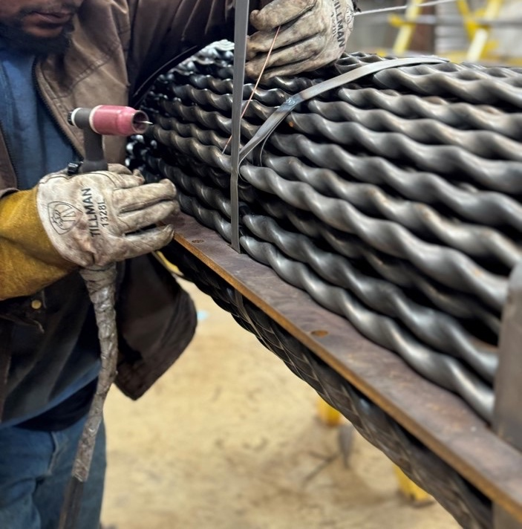
Your Strategic Partner in Thermal Excellence
Why Metalforms
Geographic advantage: Texas-based with Gulf Coast expertise
Technological differentiation: Proprietary solutions unavailable elsewhere
Operational alignment: Proven expertise in refining, petrochemical, and renewable chemical production
Sustainability focus: Energy efficiency supporting environmental commitments
Comprehensive service: End-to-end project lifecycle support with 24/7 emergency response

Slide 14
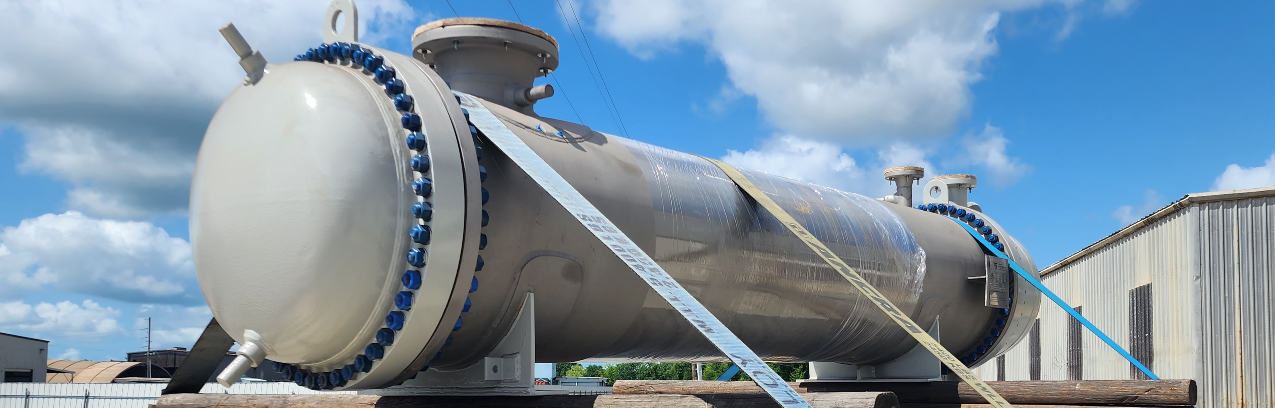
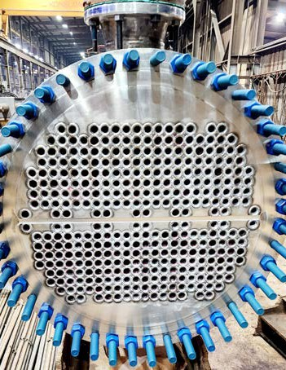
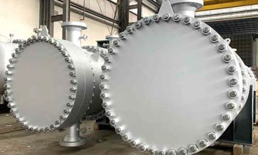
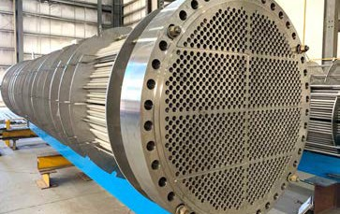
CUSTOM SHELL & TUBE HEAT EXCHANGERS
Metalforms is a leading provider of custom engineered and fabricated shell and tube heat exchangers including:
Fixed tubesheet
Floating tubesheet
U-tube
Replacement parts (bundles, shells, & channels)
All our heat exchangers are designed to standard TEMA configurations and in accordance with ASME Code, Section VIII, Division 1; TEMA class R, C & B; and APl-660. Our materials expertise includes Stainless Steel, Carbon Steel, Nickel Alloy. Duplex, and more.

Slide 15
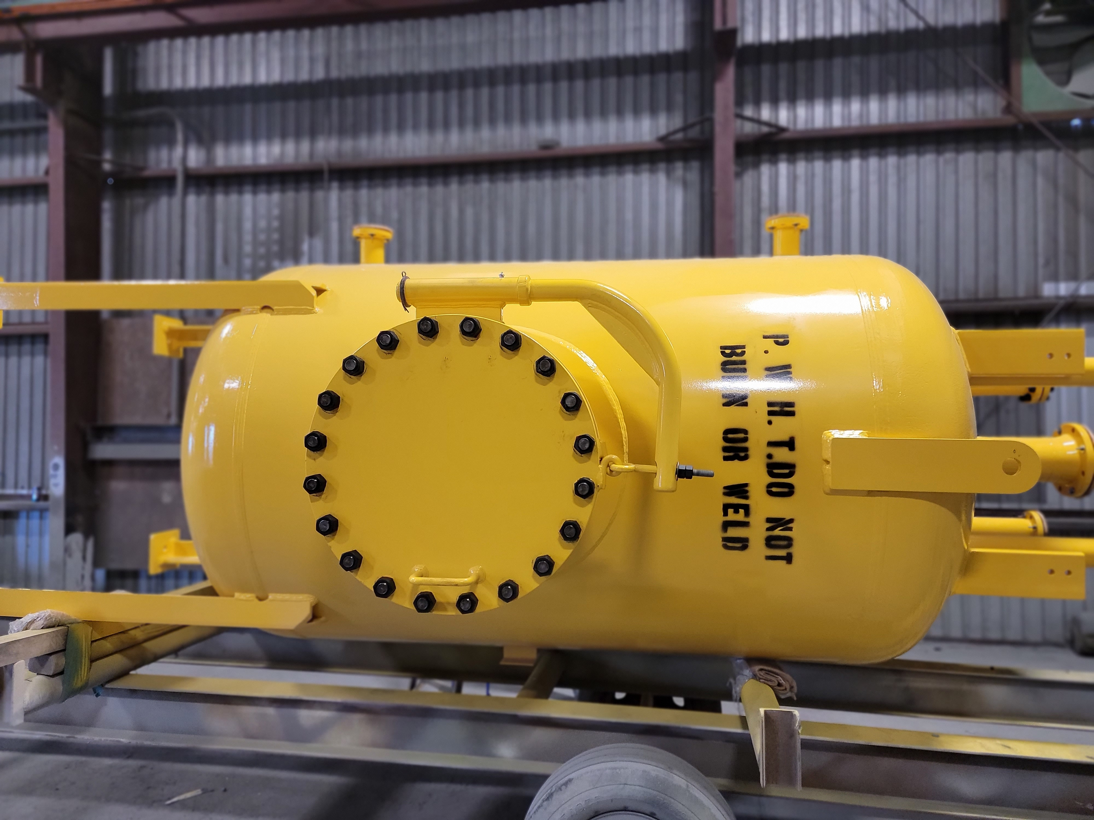
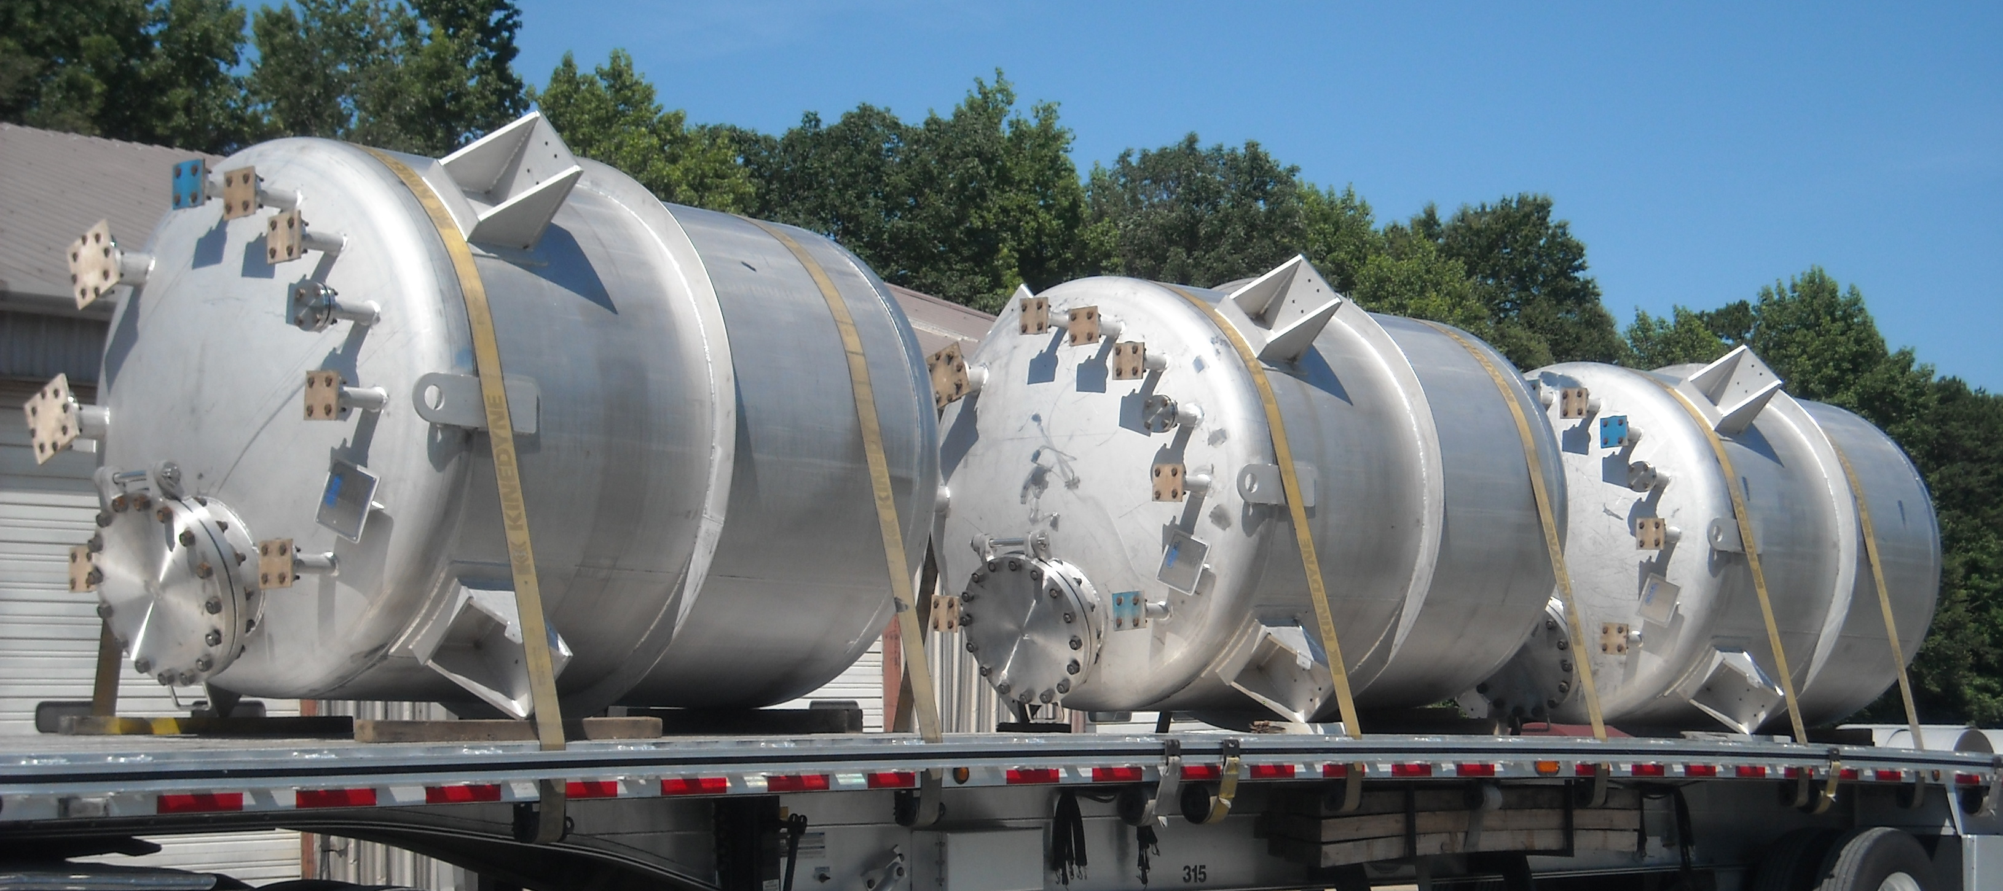
ASME PRESSURE VESSELS
Metalforms delivers high-quality, custom-engineered Pressure Vessels, built to each client’s specific application requirements. Every vessel is engineered and fabricated in strict accordance with ASME Code. Available in Stainless Steel, Carbon Steel, Nickel Alloy, and Duplex.
Example ASME pressure vessel projects include:
• ASME Storage Vessels • Process Reactors • Separators • Heat Exchangers • Distillation Columns • Boilers | • Pressure Filters • Storage Bullets • Absorbers • Catalytic Converters • Pressure Vacuum Vessels • Blowdown Drums

Slide 16
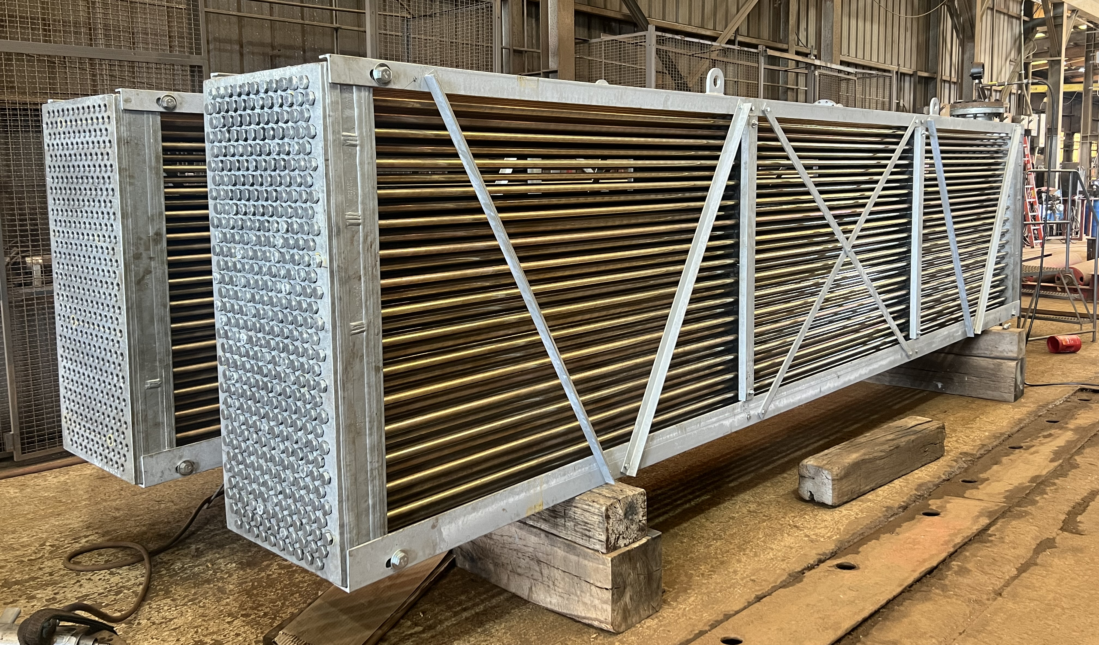
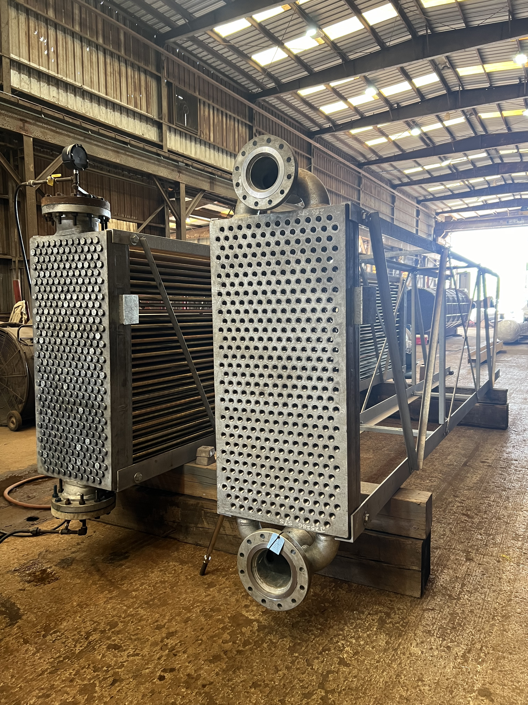
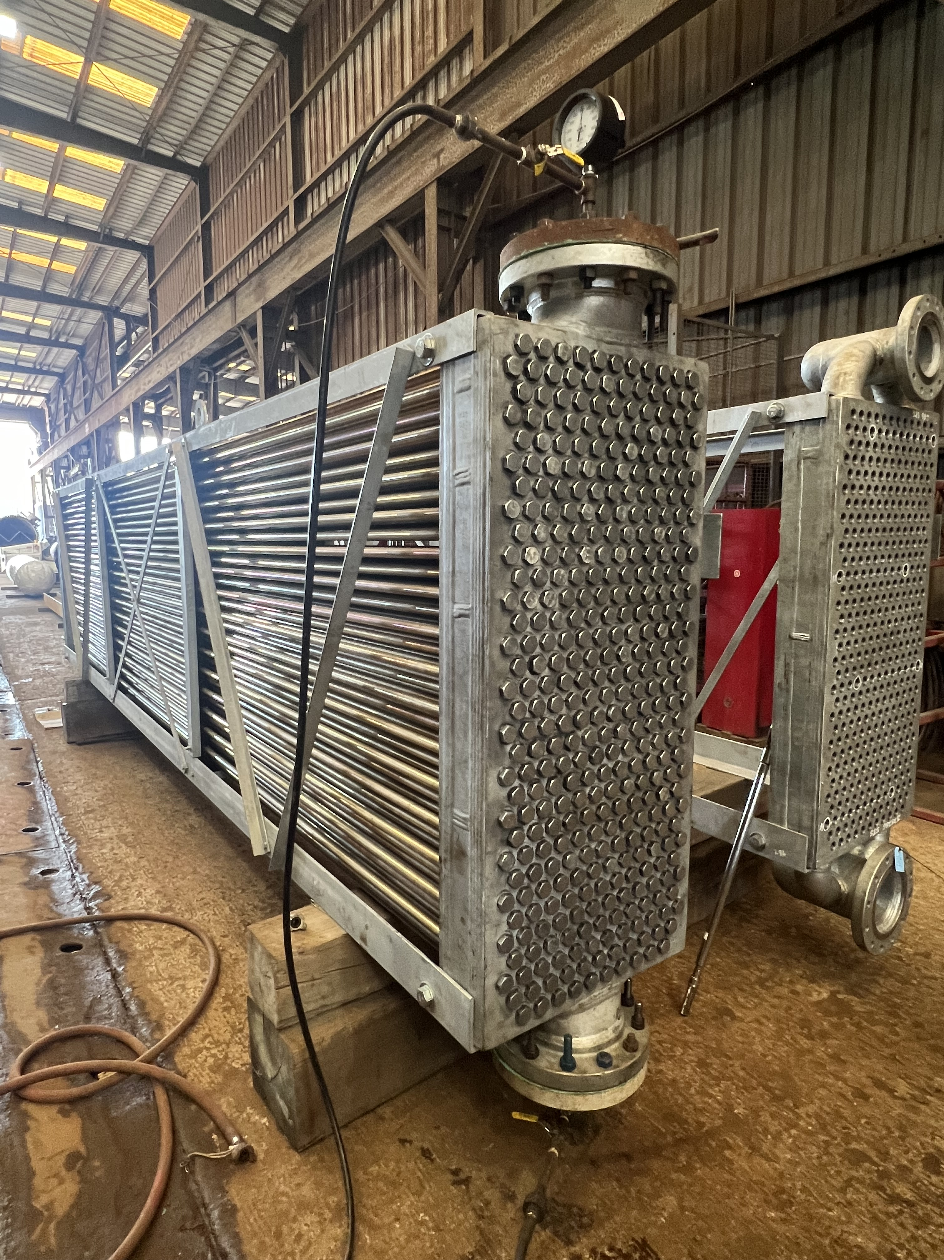
AIR COOLED HEAT EXCHANGERS
Metalforms delivers high-quality, replacement bundles to support plant operations.
Our team also has the experience and capability in performing strip and retube services for air cooled heat exchangers.
Replacement bundles
Replacement header boxes
Strip & Retube services
Replacement header plugs

Slide 17
HAIRPIN HEAT EXCHANGERS

Slide 18
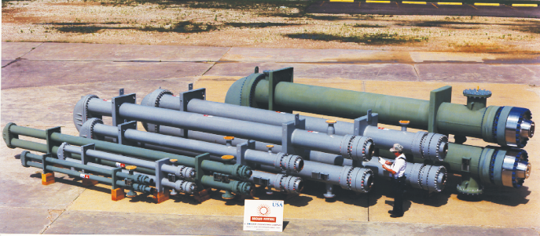
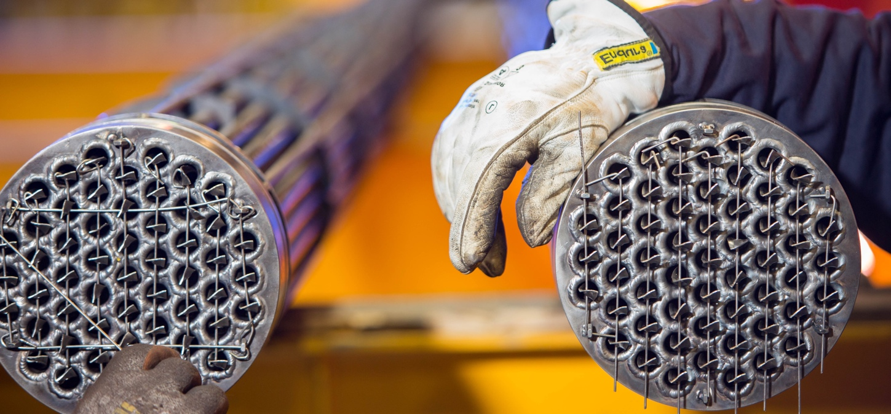
History of innovation
Started as Bas Tex
Double Pipe Exchangers
Bare tube pipe inside larger pipe
BROWN FINTUBE® acquired Bas Tex
Introduced Finning technology to Double Pipe
More surface area means less weight, space, and cost
Revolutionized the double pipe market
Installed base in most refining and Petrochemical plants globally
Koch Heat Transfer acquired BROWN FINTUBE®
Expand size range to 36-40” diameter Multi Tubes
Added closure technology including High Pressure
Metalforms acquired KHT assets

Slide 19
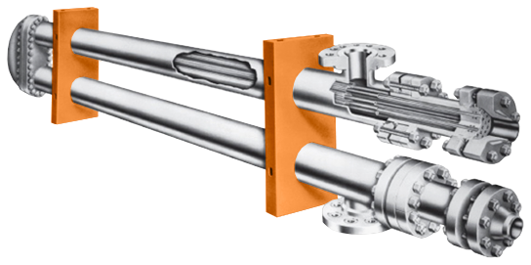
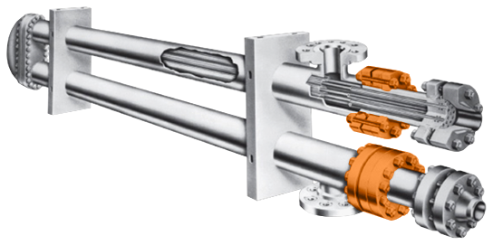
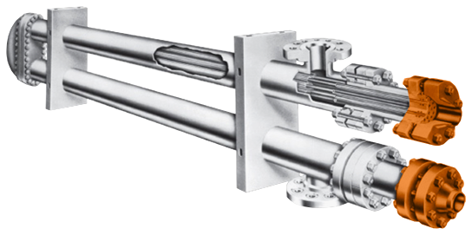
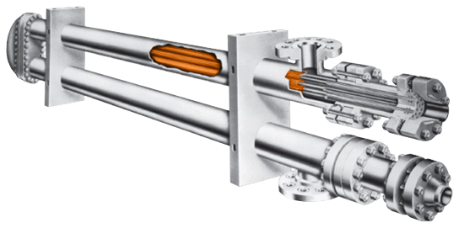
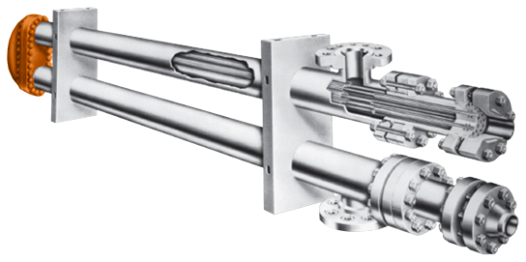
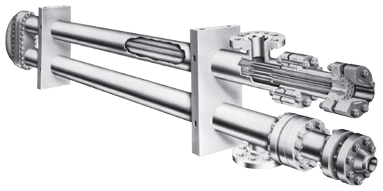
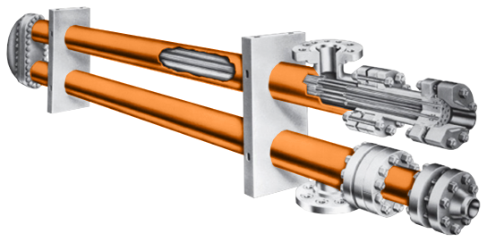
Brown fintube® products – hairpin heat exchangers
What is a hairpin?
Simply put: A single-pass shell & tube in counter-current flow
folded into a u-shape or hairpin configuration.
The bundle is removed by disassembling the closure, removing the bonnet, and pulling the bundle from the back end of the exchanger.
Shell
Bundle
Bonnet
Supports
Shell-side
Closures
Tube-side
Closures

Slide 20
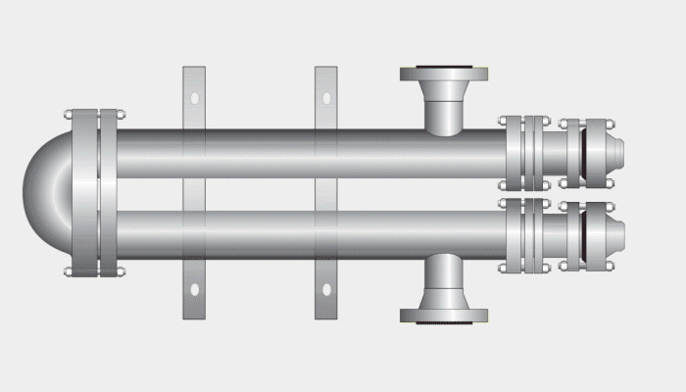
Brown fintube® products – hairpin heat exchangers
Maximizes Temperature Efficiency Through Pure Countercurrent Flow
No leaf seals or long baffle means no flow or thermal leakage
Eliminates Need for Expansion Joints or Bellows (Weakest Link)
  For external expansion joints, temperature profiles distributed between two separate legs and large-radius U-bends.
  For internal expansion joints, can obtain a removable bundle, single-pass design without the need for the expansion joint.

Slide 21
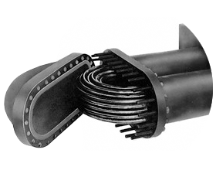
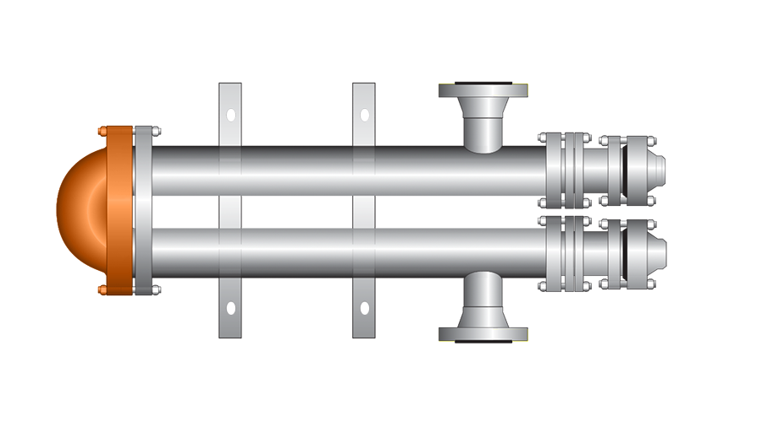
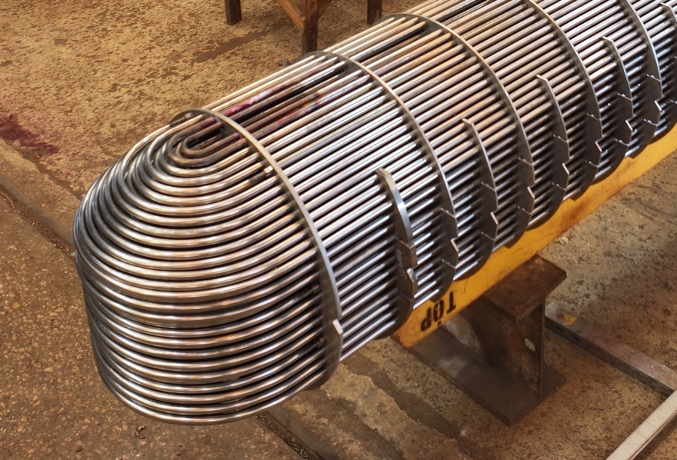
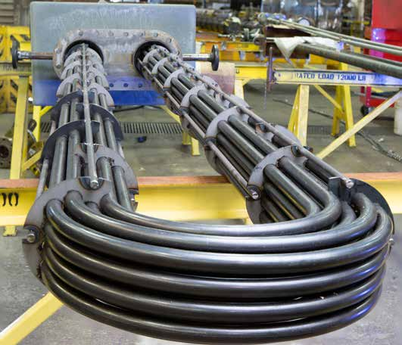
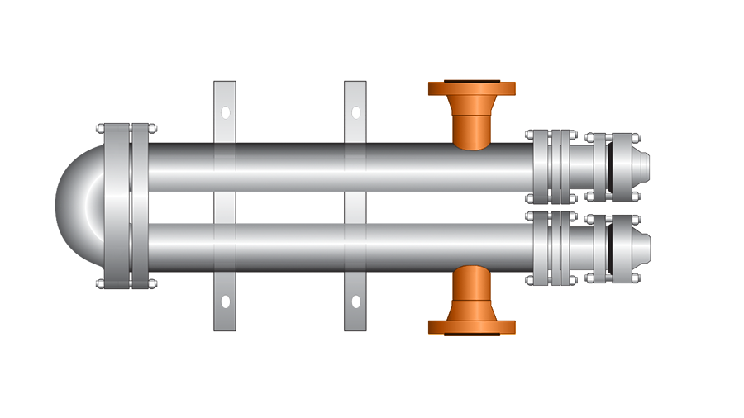
Brown fintube® products – hairpin heat exchangers
Large Radius U-bends Allow for Thermal Expansion and Cleaning
Same-End Nozzle Location Minimizes
Thermal Stresses on Piping
Shell and Tube U-bundle
Hairpin U-bundle

Slide 22
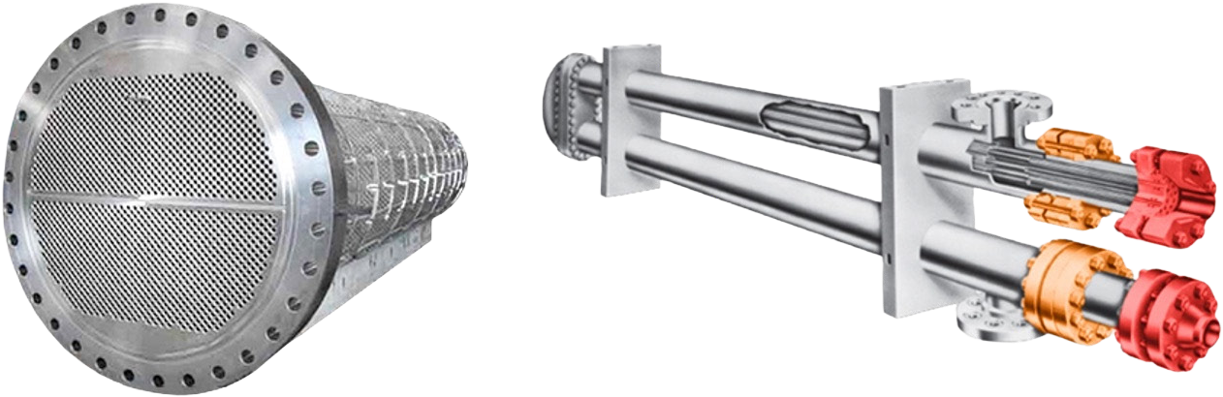
Brown fintube® products – hairpin heat exchangers
Separate Terminal vs Common Closure Designs
Tube-side
closures
Shell-side
closures

Slide 23
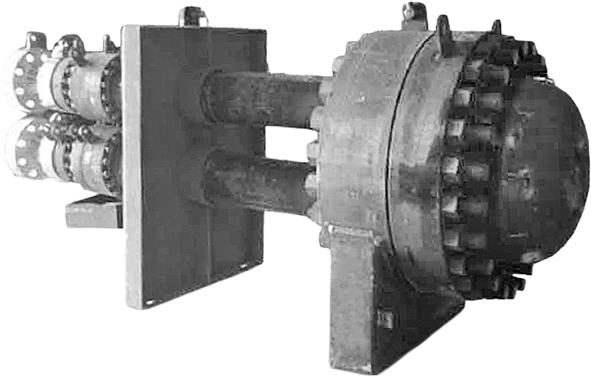
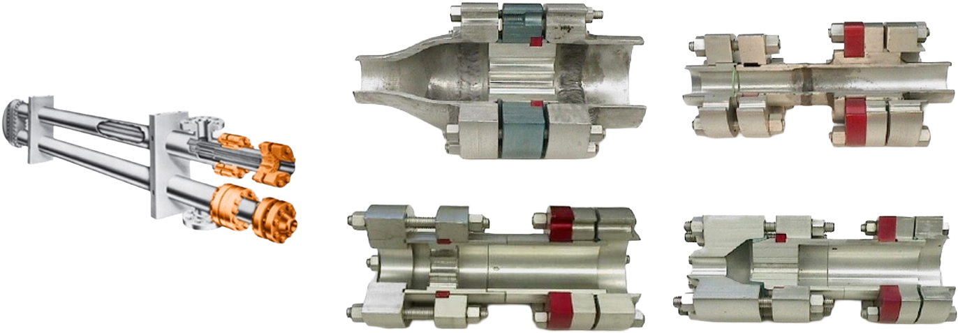
Brown fintube® products – hairpin heat exchangers
12” Multitube, 2,990 psi Tube-side & Shell-side
Smaller Flanges and Bolting for High-Pressure Applications
Variety of Closure Types
Separate Sealed LOK-FLANGE®
Separated-head Double-pipe
Medium-pressure
Separated-head
High-pressure
TAPER-LOK® CLOSURE

Slide 24
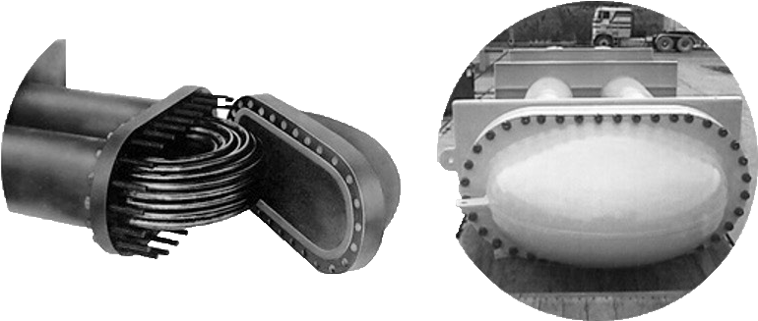
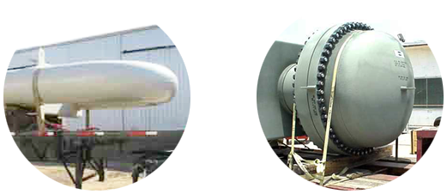
Brown fintube® products – hairpin heat exchangers
Variety of Multitube Return Bend Closures
Elliptical bonnet
Round TAPER-LOK®
bonnet
All welded

Slide 25
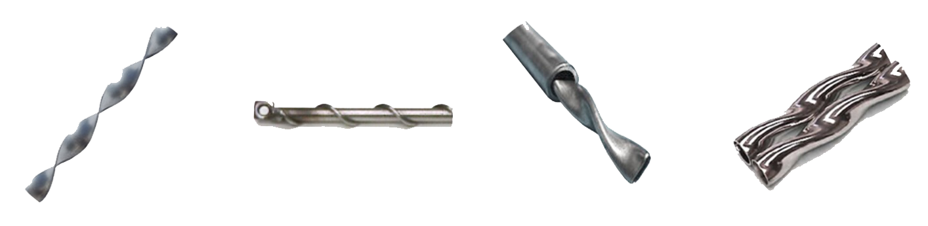
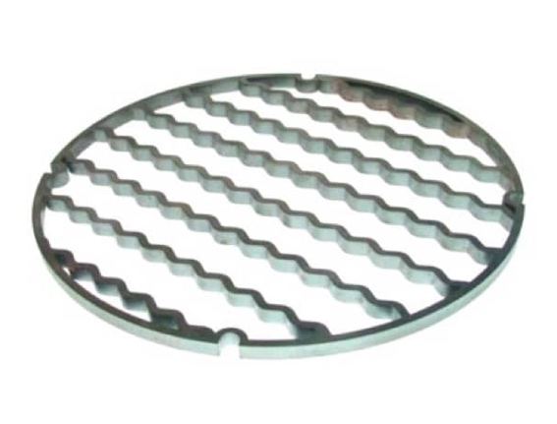
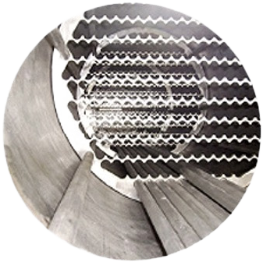
Brown fintube® products – hairpin heat exchangers
Tube-Side Heat Transfer Enhancement
Wire-wrapped Cores
HELI-CORE™ Tube Inserts
TWISTED TUBE® Bundle
Turbulators
A Hairpin Heat Exchanger Can Minimize Risk of Flow-Induced Vibration
LOK-BAFFLE™ Tube supports:
Pure longitudinal flow
Grids supporting the tubes even on triangular pitch
Much lower shell-side pressure drop with respect to segmental baffles

Slide 26
Brown fintube® products – hairpin heat exchangers
Consider a Hairpin When…
A temperature cross exists or close temperature approach is desired
High pressure applications exist
Cycling and thermal shock conditions are present
High terminal temperature differences exist
Avoidance of an expansion joint
Ability to clean u-bends is required
All external bolting is desired
An augmentation device would improve heat transfer

Slide 27
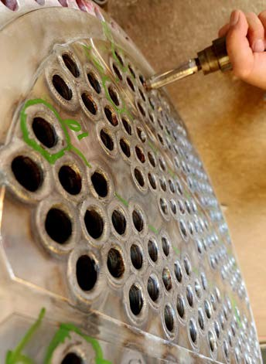
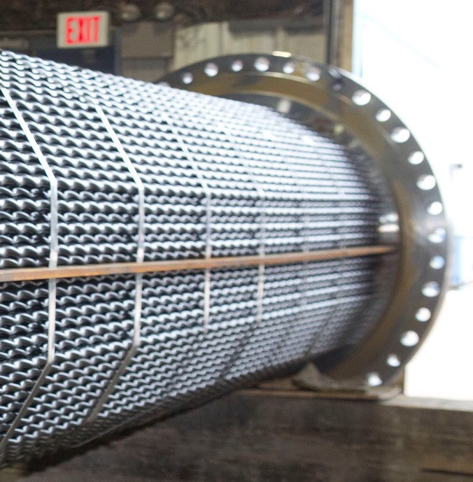
EMERGENCY REPAIRS & SERVICES
Metalforms understands that heat exchangers are a critical process component, and when repairs are needed, they are often needed quickly. When time is critical and you need your heat transfer equipment repaired rapidly and correctly, Metalforms has the expertise and capabilities to handle all types of repairs to get your unit back up and running. Common repairs we perform include
Gasket surface repair
Weld repairs
Weld build-up and re-machining
Replacement components
Repairs to shell and channel components
Coating and paint application
24/7 Responsiveness and Capabilities

Slide 28
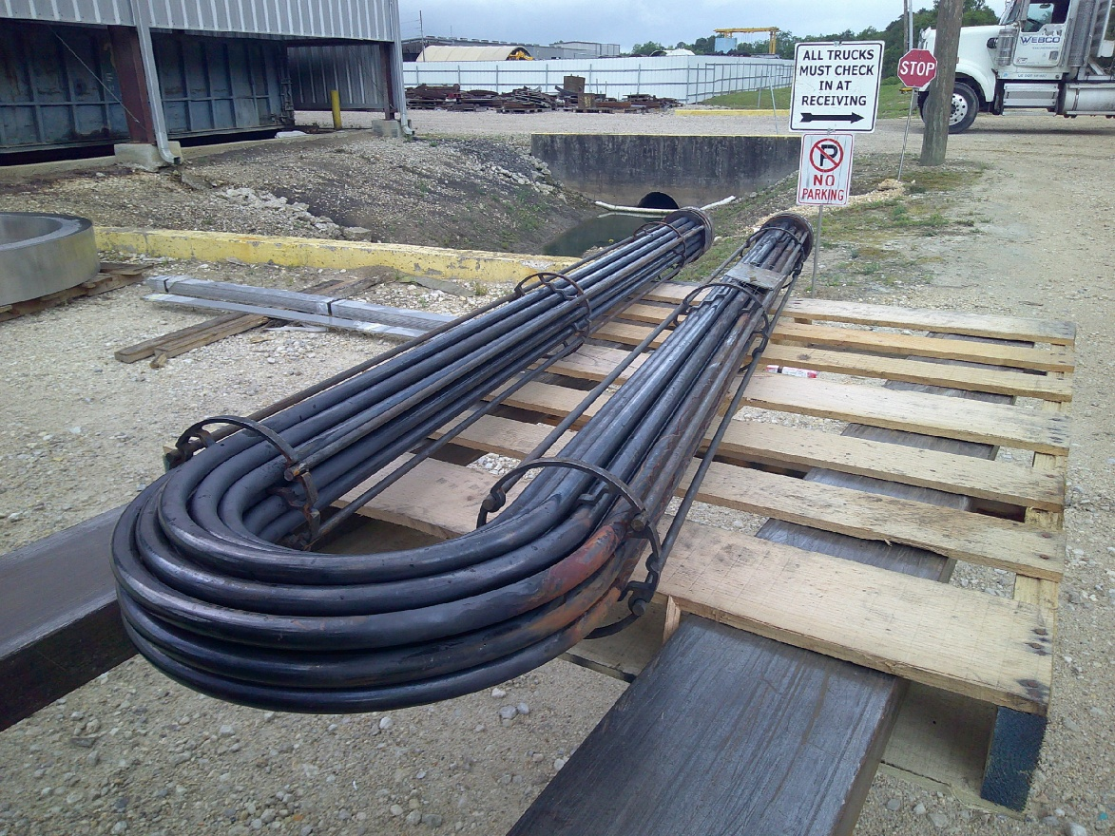
EMERGENCY REPAIRS & SERVICES
CASE STUDY: EMERGENCY HAIRPIN RETUBE
Client identified a leaking bundle due to steam fretting
Replacement bundle was not feasible due to critical lead time required
Working with our MHT and MHX teams, we were able to provide an OEM repair by retubing the existing bundle.
The window to complete this repair was 36 hours to avoid unit shut down.
Our team worked around the clock and completed the repair
The plant was able to install the bundle and operate at full strength.

Slide 29
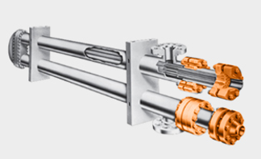
PLANT EQUIPMENT SURVEYS
CASE STUDY: PLANT EQUIPMENT SURVEY
Client wanted quick access to critical information on 26 Hairpin Heat Exchangers in their Alcohol plant
Brown Fintube® was the OEM for some of the exchangers, but not all
MHT technician went to site with our HTS-LA representative and took photos of all nameplates and dimensional measurements on some exchangers
MHT provided the critical information to the customer in an electronic file:
  GA drawings
  Parts list/BOM
  Torque Values
  Upgraded components
MHT is evaluating more efficient ways to provide this information to customers – Customer Portal on our website

Slide 30
MAJOR WIN IN SULFUR, LA
CASE STUDY: DOUBLE PIPE REPLACMENTS
Client issued an RFQ to replace 32 banks of Double Pipes originally supplied by Brown Fintube®
Complete exchanger replacements so competition was fierce
KHT had provided one bank of exchangers prior to acquisition. They were stored in a warehouse in Lake Charles for 4 years
MHT technician went to site and inspected the exchangers. Determined they could be put back in service with no repairs.
MHT won the job through competitive bid process
Project is in the drawing submission process, currently

Slide 31
TWISTED TUBE® HEAT
EXCHANGER TECHNOLOGY

Slide 32

TWISTED TUBE® Sweet spot
Refining and petrochemical customers are continually adjusting their processes to improve performance, increase capacity, or adapt to changing operating conditions.
Process changes increase strain on existing heat transfer equipment
Traditional solutions often rely on larger or additional exchangers; this approach is not always the most efficient or cost-effective
Metalforms leverages KHT expertise to solve complex challenges
Focus on improving performance within existing equipment footprint
Avoids piping and foundation modifications
Enables upgrades without impacting turnaround schedules

Slide 33



WHAT IS A TWISTED TUBE® HEAT EXCHANGER
Q = U_{O} ^{x} A ^{x} F ^{x} LMTD
Unique helix-shaped tubes arranged in a triangular pattern
Twist arrangement for baffle-free support provides gaps between the tubes for easier cleaning on the shellside
More reliable exchanger than an ordinary shell & tube exchanger

Slide 34

TWISTED TUBE® BUNDLE CONSTRUCTION
Tubes are firmly supported
Vibration-free: Vcr > 305 m/s (1000 ft/sec)
No single tube can vibrate

Slide 35


SHROUDED TWISTED TUBE® BUNDLE CONCEPT
Q = U_{O} ^{x} A ^{x} F ^{x} LMTD
Segmental Baffle Bundle
TWISTED TUBE® Bundle

Slide 36

TWISTED TUBE® Heat Exchanger – Field Example
Fouling Trend (Crude / HVGO Pumparound)
Installed TWISTED TUBE® Bundle
2 years
5 years
1 ½ year
3 years

Slide 37

INCREASED HEAT TRANSFER SURFACE AREA
Q = U_{O} ^{x} A ^{x} F ^{x} LMTD
Segmented Baffle Bundle
400 tubes, 19.05 mm (¾”) OD on 25.4 mm
(1”) square pitch. (6896 ft2)
TWISTED TUBE® Bundle
550 tubes, 19.05 mm (¾”) OD on 22.5 mm
(8/9”) triangular pitch. (9376 ft2)
35% increase

Slide 38

IMPROVE HEAT TRANSFER COEFFICIENT
Q = U_{O} ^{x} A ^{x} F ^{x} LMTD
“The inside of a round tube is, without a doubt, the poorest place in the world where a person could affect heat transfer.
It has a uniform cross-section, it does not create randomness, and it tends to give you the least for your money when you circulate a fluid through it.”
Don Kern - 1958

Slide 39

REPLACEMENT “F” BUNDLE IN “E” SHELL
Q = U_{O} ^{x} A ^{x} F ^{x} LMTD

Slide 40








REPLACEMENT “F” BUNDLE IN “E” SHELL
$$U_{o}$$
$$A$$
$Δ$T_{lm}
$$x$$
$$x$$
U value increase due to the unique shape of the tube
Surface area increase by changing tube pitch and pattern while maintaining cleanability
Temperature difference (driving force for heat transfer) maximized by pure countercurrent flow
For new applications, look to decrease size of exchanger by affecting the parameters above.
For existing exchangers, look to maximize heat recovery or throughput by changing internals only (no effect on piping).

Slide 41


FEED EFFLUENT HEAT EXCHANGERS: FEHE Process flow diagram
Applicable to: Crude Distillation Units (CDU), Hydrocrackers, Hydrotreaters, Reformers.

Slide 42

Alternate solution at vertex refinery: fehe
REPLACE EXISTING
(2) 32-INCH DIAMETER DEU’S --> WITH
(3) 44-INCH DIAMETER DEU’S
NEW FOUNDATION
NEW PIPING
TWO YEARS LEAD TIME

Slide 43
The results
 | VGO Service | Renewable Diesel | TWISTED TUBE® Heat Exchanger – Results
Size (2 units in series) | 38” X 264” –DEU (NTIW) | 38” X 264” –DEU (NTIW) | 38” X 264” –T-DFU
Effluent Flowrate | 488,790 lb/hr | 630,069 lb/hr | ~ 30% higher throughput
Heat Recovery | 94,200,000 | 119,181,171 | ~ 26.5% higher duty
Fouling Factors | 0.001 / 0.001 (SS/TS) | 0.002/0.003 (SS/TS) | Higher / Longer run times
Shellside Pressure Drop (PSI) | 25 / 18 | 25/ 16 | Reduced Shellside Pr. Dp.
Surface Area in Existing Shells | 6896 ft2 | 6896 ft2 | 9376 ft2 (+35%)
Vibration Concerns | Possible | Present | Eliminated
Loads on Fired Heater / CO2 Emissions | Present | Present | Eliminated
Excess Heat for bypass | Not available | Not Available | Available

Slide 44

Metalforms TWISTED TUBE® HEAT EXCHANGER DESIGN SOLUTION AT VERTEX REFINERY: FEHE
"TWISTED TUBE® Heat Exchanger Bundles have helped beat the volume gains by quite a few barrels, saving significant money”
“These units have been performing so well we have to bypass some effluent – unlocking extra heat for efficiency”
“Units have been working efficiently in both services”
“No worries about the fired heater - We could operate the heater just by lighting up a candle”
Client Feedback

Slide 45


TWISTED TUBE® HEAT EXCHANGER TUBESIDE & SHELLSIDE CLEANING
TUBESIDE CLEANING
SHELL-SIDE CLEANING

Slide 46
CHANNEL PARTNER PRESENCE

Slide 47

U.S. Channel Partners

Slide 48

Global channel partners

Slide 49
TRANSTECH GROUP PARTNERSHIP

Slide 50







Our core values
The TransTech Way: We define our success by how we impact the lives of the people around us, our Team Members, our Customers, our Supply Partners, and our Communities.
Goal Zero Safety
Doing everything we can to keep employees out of harms way.
Thinking Win-Win
Using our knowledge and experience to collaborate with all stakeholders and bring the best solutions to clients.
Accountability
Committing to each other and being honest on all individual and collective goals.
Pursuit of Excellence
Always learning, adapting, and finding better ways to service our clients, team, vendors, and community.
Care Driven
Passionately concerned with the quality and impact of our work; upholding the dignity and value of others.
Teamwork
Competitive enough to push for better results and thoughtful enough to help others.

Slide 51









Transtech group at a glance
Our integrated capabilities enable world-class projects that reduce risk and improve performance across the plant lifecycle, lowering costs and maximizing ROI.
Engineered Products
Workforce
Customers
950+
Employees
Owner Operators
EPCs
Investors & Developers
Municipalities
150+
Field Services Team Members
Our Expertise
80+
Engineers
Development Support
Engineering
Fabrication
Construction / Management
MRO Services
400+
Welders, Fabricators,
Quality Inspectors
Capital Assets
850,000 ft²
Fabrication Capacity
Certifications
Services
Acres of Vessel & Equipment Storage/Staging
ASME, U, U2, U3, S
NBIC
TEMA Class R, C, B
API 660, 650, 620
NACE
CSR, SPRAT
Services
180+
10
Fabrication Facilities

Slide 52












Industries we serve
Energy & Power Generation
Air Separation
& Industrial Gas
Food & Beverage
Oil & Gas
Specialty Chemical
Data Centers
Petrochem / Refining
Water / Wastewater
Aerospace
Renewables & Biofuels
Industrial / Manufacturing
Semiconductor

Slide 53

Engineered products group
High-performance, custom-engineered solutions for heat transfer and process applications. We deliver turnkey equipment including heat exchangers, pressure vessels, distillation columns, towers, and tanks—all built to ASME, API, TEMA, and NBIC standards.
Materials Expertise
Custom Fabrication
Carbon steel, stainless steel, and specialty alloys for any application.
Turnkey solutions designed and built to your specifications.
Quality Standards
Nationally recognized certifications and rigorous testing.

Slide 54





Our engineered products brands
Engineering and custom fabrication of ASME pressure vessels, storage tanks, process equipment, and process piping
for energy and industrial applications, with special expertise in oversize, heavy wall pressure vessels and complex
multi track projects.
Custom design and fabrication of ASME pressure vessels, reactors, storage tanks, and heat exchangers for virtually
any process industry application.
Custom design, fabrication, and repair of shell and tube heat exchangers and ASME pressure vessels, including
24/7 repair, replacement, and bundle shop services. Custom heat exchanger solutions for energy efficiency and facility throughput, featuring specialized heat transfer technologies such as TWISTED TUBE® and BROWN FINTUBE®.
Engineered industrial gas and cryogenic equipment solutions and services, including bulk liquid cryogenic storage,
transportation, and high-pressure cylinder filling systems.
India-based engineering and fabrication company delivering OEM manufacturing and custom-engineered process
equipment for global energy and industrial infrastructure markets.

Slide 55

Services group
Integrated shop- and field-executed services supporting complex infrastructure across the complete asset lifecycle—from greenfield development to decommissioning.
Custom EPC Services
Construction Management
Field Installation & Integration
Repair & Maintenance Support
Turnarounds & Retrofits
Operations Support

Slide 56



Our services brands
Turnkey design, fabrication, installation, commissioning, maintenance, and repair services for LPG, LNG, SNG,
and alternative fuel gas systems, including storage, transfer, and utilization solutions for liquefied gases.
Cryogenic and mechanical field services for critical air separation and process industry infrastructure, including
turnaround support, equipment installation, process piping, and oxygen cleaning.
Engineering, procurement, construction, operation, and maintenance services for biogas to energy and RNG projects,
including infrastructure development, O&M support, controls integration, and SCADA and asset optimization.

Slide 57









End-to-end solutions – Delivered through one integrated platform
Our integrated capabilities support large-scale industrial projects by delivering seamless, end-to-end solutions across the plant lifecycle, improving performance, reducing complexity, lowering costs, and maximizing ROI.
Operating Divisions
Capabilities Shared Across All Divisions
Warranty
Support
Design
Engineered Equipment Fabrication
Specialized Mechanical Services
Maintenance,
Repair,
Operations
Engineering
Energy Solutions
Renewables Solutions
Installation,
Construction, Commissioning
Project
Management
Cryogenic Solutions
Heat Transfer Solutions
Fabrication,
Manufacturing
Procurement

Slide 58


Why choose transtech group
Quality & Safety
Projects delivered to the highest standards with rigorous
safety protocols and nationally recognized certifications.
Speed & Efficiency
Streamlined execution with interdisciplinary teams
working seamlessly from design through delivery.
Simplified Process
One point of contact, one invoice—eliminating complexity
across your entire project.
Complete Lifecycle Support
From initial design and fabrication through installation,
maintenance, and long-term support.

Slide 59
LOCATIONS

Slide 60

Our nationwide presence
Our Facilities
Houston, TX
Montgomery, TX
Beaumont, TX
McGregor, TX
Charlotte, NC
Rocky Mount, NC
Wilmington, NC
Rock Hill, SC
Cleveland, OH
Indianapolis, IN
Denver, CO
Missoula, MT
Sisters, OR

Slide 61

Locations & Channel Partner Network
Our global presence
United States*
Italy*
India*
Canada
Brazil
Colombia
Argentina
Chile
Peru
Ecuador
Saudi Arabia
Qatar
Nigeria
South Korea
Japan
Thailand
Taiwan
* TTG Facilities

Slide 62















































A few of our customers

Slide 63
We're ready to demonstrate how our capabilities translate into tangible value for your operations.
Let's begin the conversation today.
Contact Information
Alvin Jones
Director, Global Sales and Channel Strategy
832-392-6698
ajones@metalformsht.com
Metalforms
📞 (713) 466-3535
🌐 www.metalformshx.com
Clint Martin
Director of Commercial Operations
409-241-1372
cmartin@metalformshx.com

